Slide 1
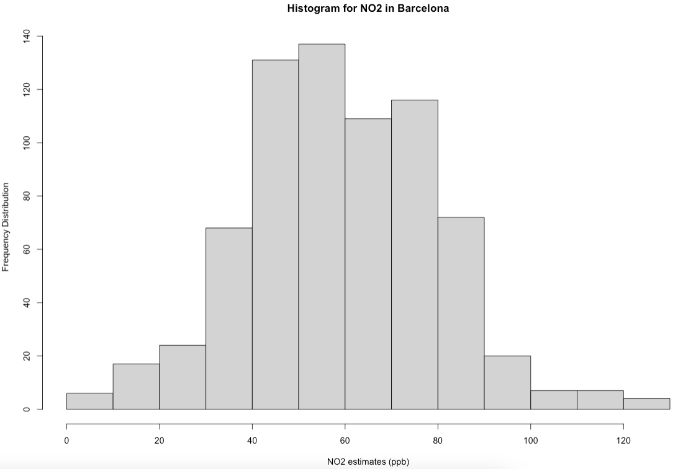
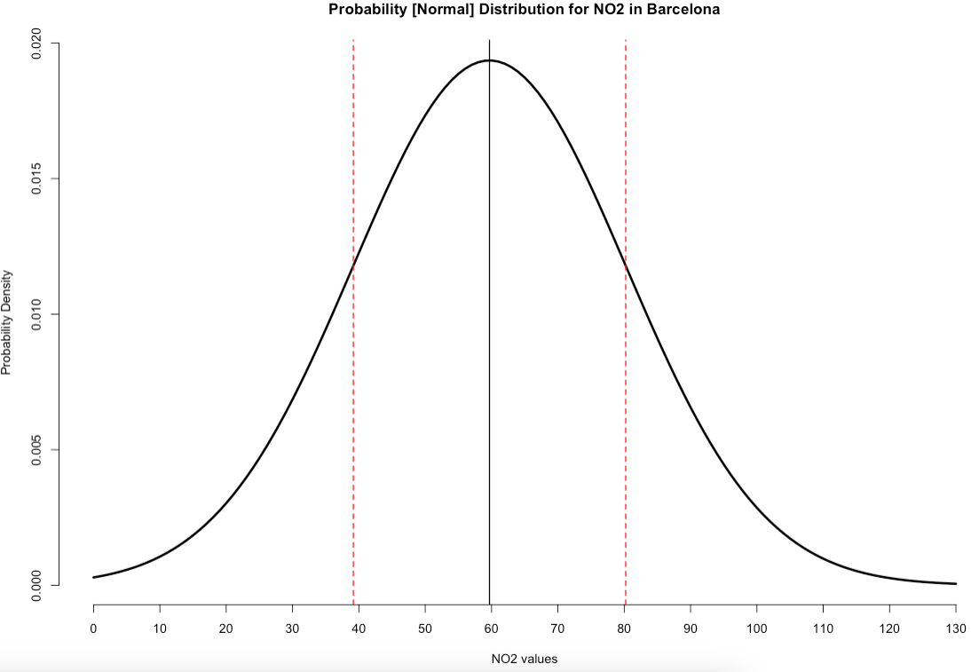
What is a Probability Distribution?
A: Histogram showing us the frequency distribution of the observations
B: Normal distribution curve based on the mean and standard deviation
In last week’s workshop. We analysis air pollution data from Barcelona. We were to perform some general descriptive analysis on these NO₂ values and found the mean = 59.69ppb and standard deviation = ±20.63. Now, we want to generate a distribution so as to make simple probabilistic predictions about air pollution levels in Barcelona.
Notes:
This video is to just give you a quick recap and context of this part of the workshop.
In last week's session, we learned some basic coding in R, and performed some basic descriptive stats on pollution data from Barcelona.
A probability distribution is a mathematical function that describes the probability of different possible values of a variable
As stated, the Normal Distribution, which is a bell-shaped curve, is the most “famous” and widely used probability distribution because - surprisingly - a lot of measurable phenomena that are continuous data tend to be approximately bell-shaped.

